Slide 1
Python for Data analysts
Drug consumption
Pieter ALGERA IBO A5 Cyber sécurité

Slide 2
Context
The database contains basic information for each person: level of education, age, gender, country of residence and ethnicity
Each person also has information about their personality. Personality measurements (neuroticism, extraversion, openness to experience, agreeableness, and conscientiousness), impulsivity, and sensation seeking
We also have information that tells us which drug a person has used in the past and when.

Slide 3
Objective
Find the using habits of people from around the world.

Slide 4
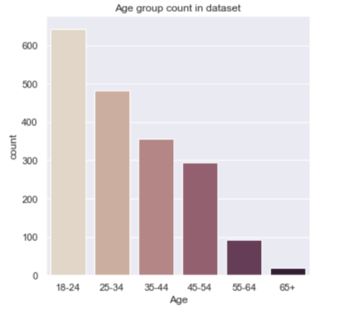
Basic Information
As would be expected, we have a lot more young people responding to the survey as we have old people as young people would have a bigger chance of seeing and responding to a query

Slide 5
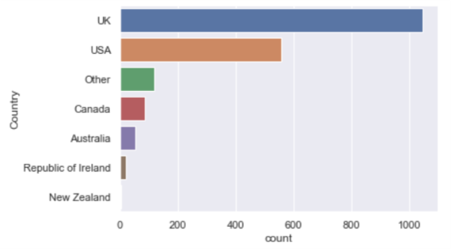
Basic Information
Here we can see the repartition of different countries in the dataset

Slide 6
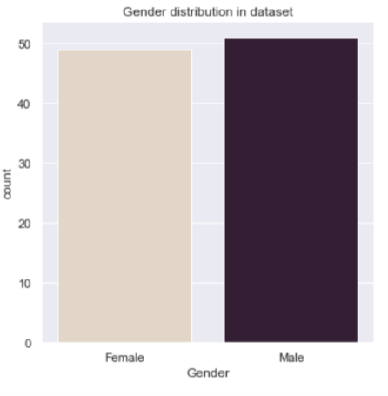
Basic Information
There are equal amounts of women and men in the dataset

Slide 7
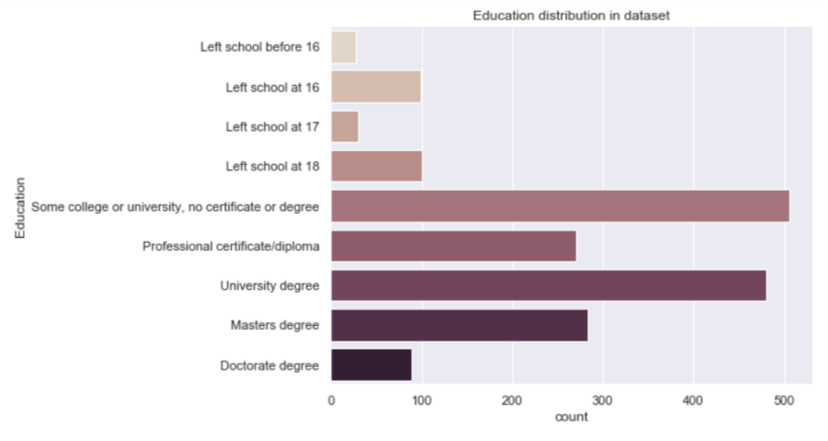
Basic Information
There is a wide variety of different education levels given in this dataset. This will mean we can get more pertinent results.

Slide 8


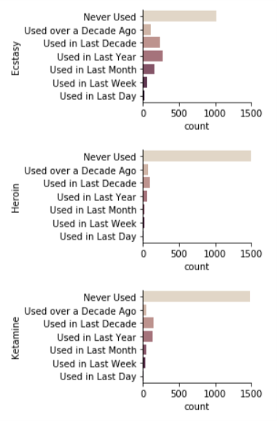
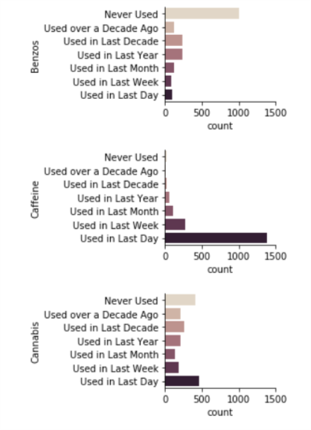
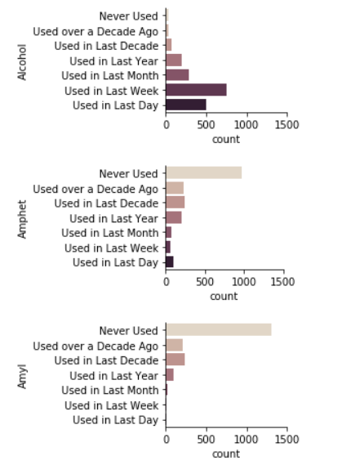



Drug usage
Here are some of the drug usage graphs. We can see that the drugs have a very different usage amount depending on the severity of the drug. For example, Caffeine is used by a lot of people while something like Heroin is used by only a few.

Slide 9
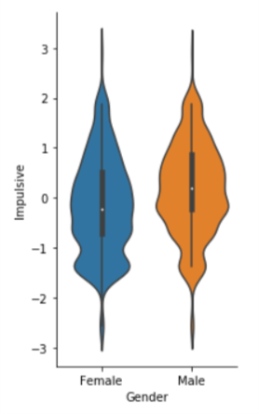
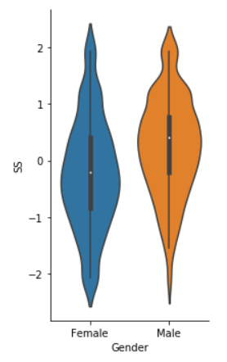
Personality score
Of the different personality traits, I want to highlight 2; The Impulsiveness and the Sensation seeking traits
We can see that men are more impulsive and are looking for more sensations

Slide 10
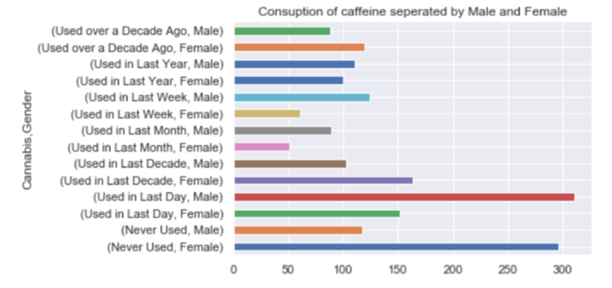
Cannabis use grouped by Gender
From this graph, we can see that men use more drugs than women.

Slide 11
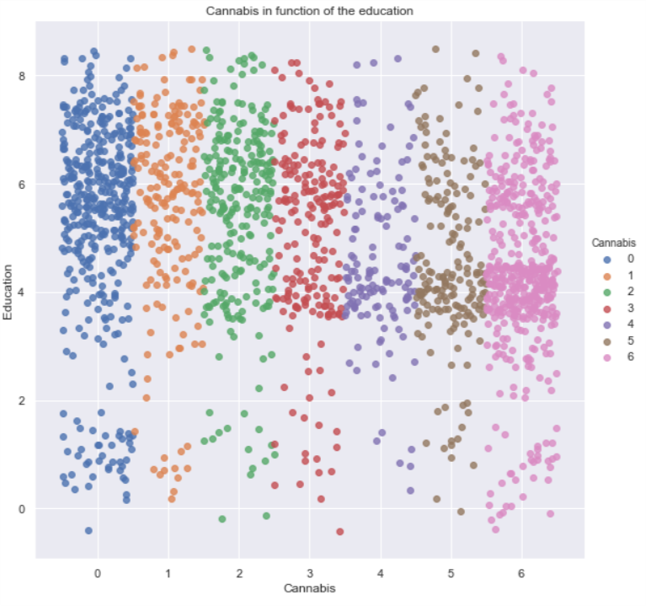
Cannabis usage in function of the education
Looking at this graph, we notice that the most usages of Cannabis is from people who are currently in college or university.
We could hypostasize that the stress from university pushes people to look for a way to relax.

Slide 12
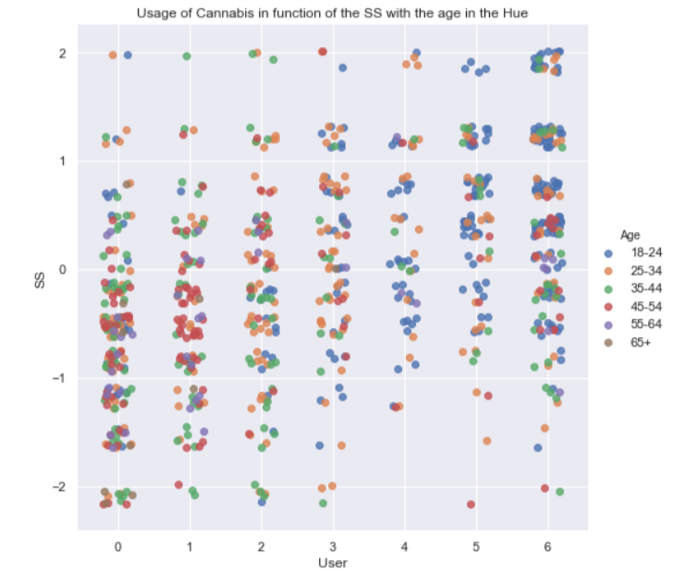
Usage of Cannabis in function of the SS
If we look at the usage of Cannabis and the Sensation seeking of each person, we see a clear correlation with the 2 variables. The more you seek sensations, the more you are likely to use Cannabis.

Slide 13
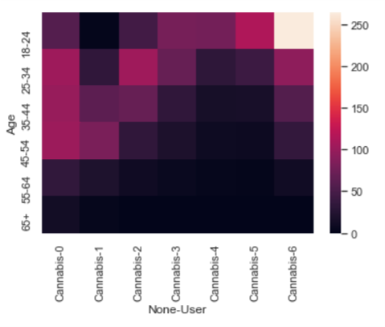
Cannabis usage in function of the Age
By looking at this Heatmap, we can see that young people are more likely to use Cannabis
This is in accord with what we saw before as the most users of Cannabis are university students.

Slide 14
Results
Looking at the different graphs for the usage of Cannabis we can make a deduction.
Cannabis users are likely to be young, Male, and in University
We should remember also that the dataset contains a lot of younger people and so our results would show more points for young people.

Slide 15
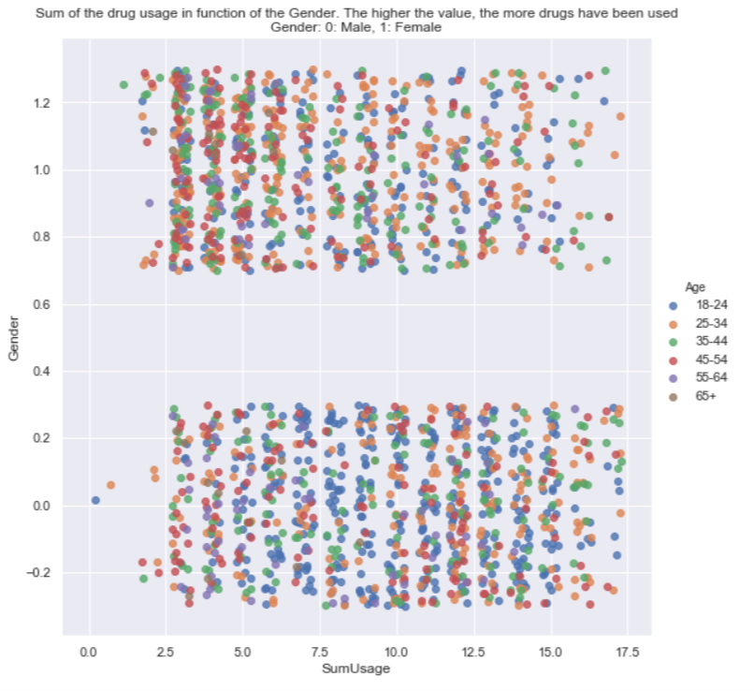
All over drug use
We can infer from this graph that male participants use more different types of drugs than females.
We also notice that the participants are very active in their drug discovery

Slide 16
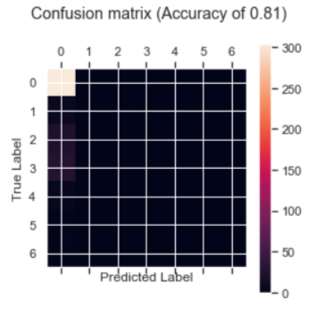
Predicting if a user will be addicted to Ketamine
Using the SVM to predict if a user will be a ketamine user.
We have an accuracy of 0.81

Slide 17
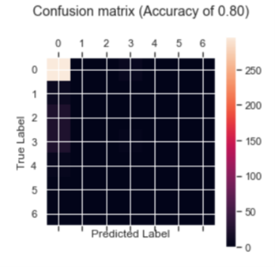
Predicting if a user will be addicted to Ketamine
Using the KNN to predict if a user will be a ketamine user.
We have an accuracy of 0.80

Slide 18
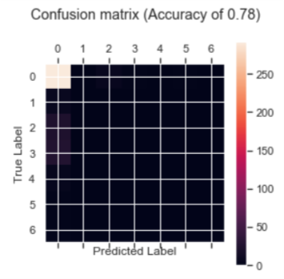
Predicting if a user will be addicted to Ketamine
Using the CLF to predict if a user will be a ketamine user.
We have an accuracy of 0.80

Slide 19
Results
The SVN Algorithm works the best to predict if a user will be a ketamine user.

